Slide 1

Distributed System Lab (Week 2)
Parallel Programming Using Threads
Department of Computer Science & Engineering
Motilal Nehru National Institute of Technology Allahabad
Prayagraj - 211004, India
September 2021

Slide 2
Process and Threads
Process
Thread 1
Thread 2
Process priority
Process id
Process state
Register
Etc.
Thread 3

Slide 3
Threads and its types:
Thread is a single sequence stream within a process.
Each thread has:
A Thread ID
A program counter
A register set
A stack space
Threads are not independent of each other as they share the code, data, OS resources etc.

Slide 4
Threads Cont’d:
Similarity between Threads and Processes –
Only one thread or process is active at a time
Within process both execute sequentially
Both can create children
Differences between Threads and Processes –
Threads are not independent, processes are.
Threads are designed to assist each other, processes may or may not do it

Slide 5
Process | Thread
Process means any program is in execution. | Thread means segment of a process.
It takes more time to terminate. | It takes less time to terminate.
It takes more time for creation. | It takes less time for creation.
It also takes more time for context switching. | It takes less time for context switching.
Process is less efficient in term of communication. | Thread is more efficient in term of communication.
Process consume more resources. | Thread consume less resources.
Process is isolated. | Threads share memory.
Process is called heavy weight process. | Thread is called light weight process.
Process switching uses interface in operating system. | Thread switching does not require to call a operating system and cause an interrupt to the kernel.

Slide 6
Types of Threads:
User Level thread (ULT) – Is implemented in the user level library, they are not created using the system calls. Each ULT has a process that keeps track of the thread using the Thread table.
Advantages of ULT –
Can be implemented on an OS that doesn’t support multithreading.
Simple representation since thread has only program counter, register set, stack space.
Simple to create since no intervention of kernel.
Thread switching is fast since no OS calls need to be made.
Disadvantages of ULT –
No or less co-ordination among the threads and Kernel.
If one thread causes a page fault, the entire process blocks.

Slide 7
Types of Threads:
2. Kernel Level Thread (KLT) – Kernel knows and manages the threads. Instead of thread table in each process, the kernel itself has thread table (a master one) that keeps track of all the threads in the system. Each KLT has Thread Table (TCB) as well as the Process Table (PCB).
Advantages of KLT –
Since kernel has full knowledge about the threads in the system, scheduler may decide to give more time to processes having large number of threads.
Good for applications that frequently block.
Disadvantages of KLT –
Slow
It requires thread control block so it is an overhead.

Slide 8
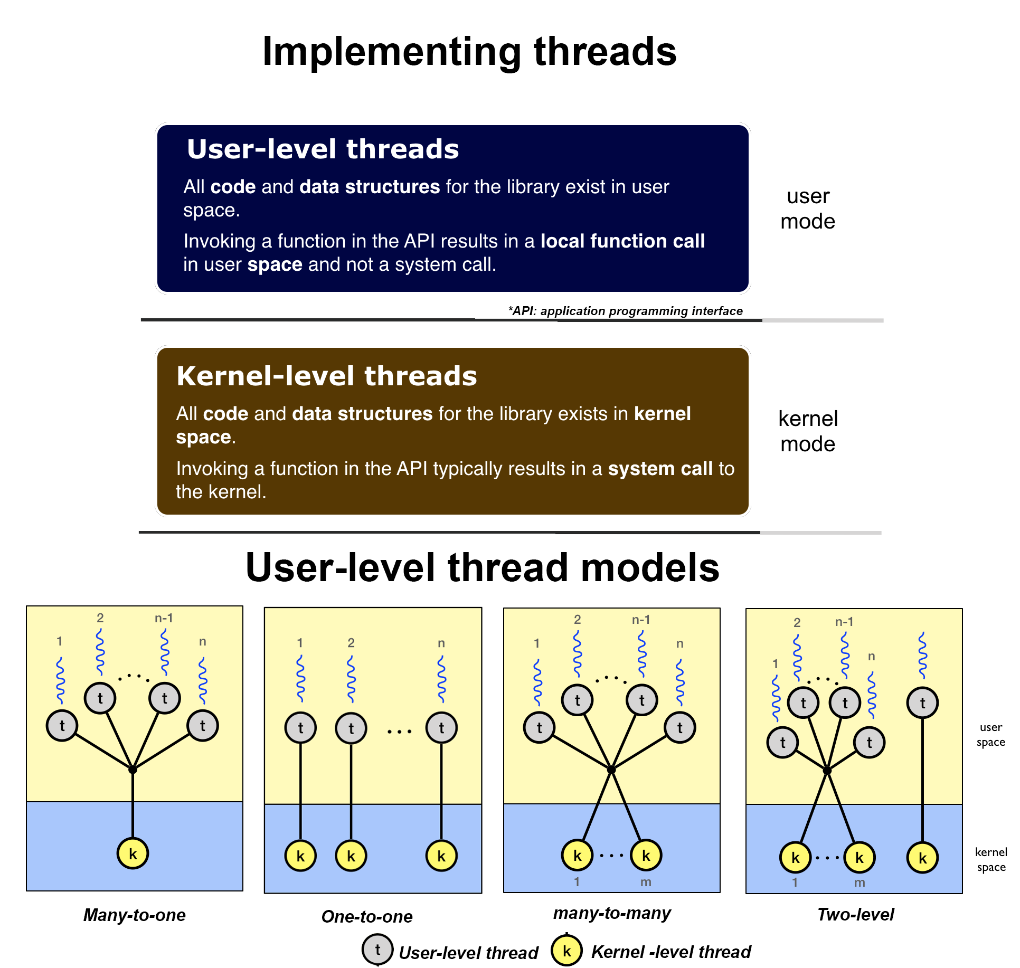
Types of Threads:

Slide 9
Multithreading in Distributed System:
Multithreading is the ability of a central processing unit to provide multiple threads of execution concurrently, supported by the operating system.
Multi threading model are of three types.
Many to many model.
Many to one model.
one to one model

Slide 10
Parallel Programming Using Threads:
A Thread Group
Share same memory
Access the same global variables
Same heap memory
Same set of file descriptors, Unlike a real process, a thread normally shares its memory with other threads
All these threads execute in parallel using time slices, or if the system has several processors, then really in parallel.

Slide 11
POSIX threads (pthreads)
#include <pthread.h>
int main(int argc, char** argv)
{
...
}
Source code needs to include pthread.h
Programs must link with the pthreads library using -lpthread

Slide 12
#include <pthread.h>
void* thread_main(void* arg) {
long rank = (long) arg;
printf("Hello from thread %ld\n", rank);
return (void*) (rank + 1);
// pthread_exit((void*) rank+1) could also be used equivalently
}
int main(int argc, char** argv) {
long n_threads = atol(argv[1]);
pthread_t* vth = (pthread_t*) malloc(sizeof(pthread_t) * (n_threads-1));
for (long rank = 0; rank < n_threads - 1; rank++) {
pthread_create(&vth[rank], NULL, &thread_main, (void*) rank);
}
printf("Hello from main thread\n");
for (long rank = 0; rank < n_threads - 1; rank++) {
long rval;
pthread_join(vth[rank], (void**) &rval);
printf("Thread %ld done, returned %ld\n", rank, rval);
}
free(th);
printf("Done");
return 0;
}

Slide 13
Output:
You may obtain (among several possible outputs):
Hello from thread 0
Hello from main thread
Hello from thread 1
Hello from thread 2
Thread 0 done, returned 1
Thread 1 done, returned 2
Thread 2 done, returned 3
Done

Slide 14
Thread Creation and Termination:
pthread_create creates a new thread:
th is the thread handle returned on exit;
attr defines the thread’s attributes (NULL for defaults);
start_routine is a function defining the entry point for the thread;
arg is the argument to pass to start_routine;
0 is returned on success, non-zero value indicates an error.

Slide 15
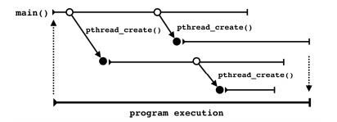
Thread Creation and Termination:

Slide 16
Thread Synchronization
Thread synchronization is the concurrent execution of two or more threads that share critical resources.
Threads should be synchronized to avoid critical resource use conflicts.
The threads library provides synchronization mechanisms: mutexes, joins, pthread_cond_t

Slide 17
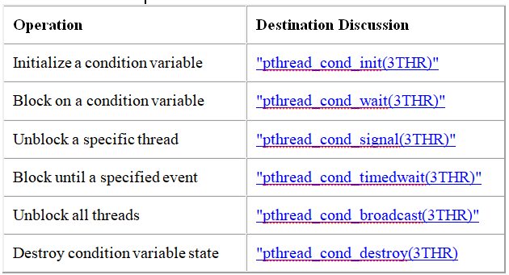
Thread Synchronization
Condition Variable functions:

Slide 18
OpenMP | Introduction with Installation Guide
Open Multi-processing (OpenMP) is a technique of parallelizing a section(s) of C/C++/Fortran code.
Portable and scalable

Slide 19
Steps for Installation of OpenMP
STEP 1: Check the GCC version of the compiler
gcc –version
sudo apt install gcc
STEP 2: Configuring OpenMP
echo |cpp -fopenmp -dM |grep -i open
sudo apt install libomp-dev
STEP 3: Setting the number of threads
export OMP_NUM_THREADS=8

Slide 20
// OpenMP program to print Hello World
//using C language
// OpenMP header
#include <omp.h>
#include <stdio.h>
#include <stdlib.h>
int main(int argc, char* argv[])
{
// Beginning of parallel region
#pragma omp parallel
{
printf("Hello World... from thread = %d\n",
omp_get_thread_num());
}
// Ending of parallel region
}

Slide 21
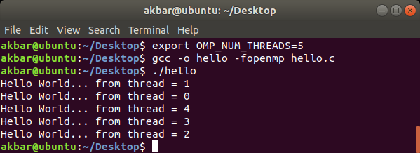
Output: When run for the 1st time:

Slide 22
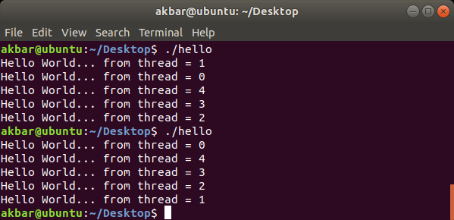
Output: When run for multiple times:

Slide 23
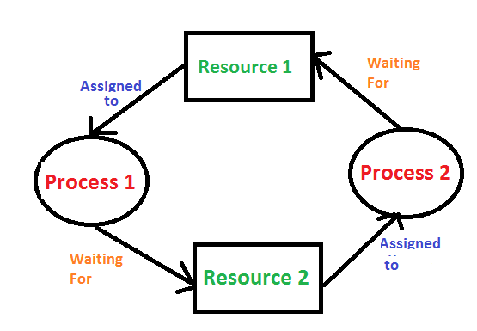
Deadlock in Distributed System

Slide 24
Deadlock Conditions
Mutual Exclusion
Hold and Wait
No Preemption
Circular Wait

Slide 25
Deadlock in Distributed System
Methods for handling deadlock There are three ways to handle deadlock
1) Deadlock prevention or avoidance
2) Deadlock detection and recovery
3) Ignore the problem all together

Slide 26
Deadlock in Distributed System
Thread 1 | Thread 2
pthread_mutex_lock(&m1); /* use resource 1 */ pthread_mutex_lock(&m2); /* use resources 1 and 2 */ pthread_mutex_unlock(&m2); pthread_mutex_unlock(&m1); | pthread_mutex_lock(&m2); /* use resource 2 */ pthread_mutex_lock(&m1); /* use resources 1 and 2 */ pthread_mutex_unlock(&m1); pthread_mutex_unlock(&m2);

